Slide 1
Coursera Capstone Project
Analysis of diversity and economy within the city of toronto

Slide 2
Introduction: Business Problem
People move to/visit cities for:
Better job opportunities
Lower commute times
Social and emotional needs
Proximity to food, entertainment and attractions
Policy-makers for the city want to find out how to boost tourism and traffic, thus enjoying economic benefits.
Question: How can a city incentivize the opening of restaurants which will in turn promote economic activity? Is there a way to do this without interfering with rents or decreasing taxes?

Slide 3
Hypothesis
An increase in cultural diversity leads to an increase in attractions (i.e. restaurants) within an area.
Since people spend money in restaurants and restaurants can encourage tourism/traffic, this will benefit the economy.
More restaurants can increase social welfare as residents have more choice regarding eating out and will be able to make choices that benefit them more frequently.

Slide 4
Data I
1) List of Toronto neighbourhoods and postal codes (source: Wikipedia, url)
All Toronto postal codes starting with M, their boroughs and underlying neighbourhoods
2) Latitude and Longitude coordinates for Toronto neighbourhoods (source: IBM)
Latitude and longitude coordinates for each of the Toronto neighbourhoods
3) Foursquare location data, retrieved through an API (source: Foursquare)
Venue locations (more specifically, restaurants) according to each of the neighbourhood latitude and longitude
4) Toronto Census Data (source: City of Toronto, url)
Aggregated demographic data on each of the city's neighbourhoods
Collected in 2016, this data was collected at the last nationwide census and includes information such as age, gender, languages spoken, income and population
Age, languages spoken and income are represented as percentage of the total respondents

Slide 5
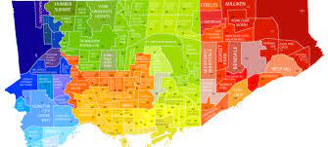
Data II
The final dataset contains:
A cross-section of 20 neighbourhoods that appear both in the list of Toronto neighbourhoods and postal codes and in the census data.
Variables:
number of restaurants
age groups
income groups
native languages
population density

Slide 6
Methodology I
Goal: Determine the impact of cultural diversity on the number of restaurants
We proxy cultural diversity using the proportion of non-native English or French speakers.
We control for: proportion of high-income households, proportion of working-age population and population density
We may expect wealthier neighbourhoods to have more restaurants as people in these areas have more disposable income to spend on eating out.
Neighbourhoods with a larger working-age population (ages 15-55) may also have more disposable income to spend. Younger individuals also tend to go out more than their older counterparts.
A higher population density means that there is a larger customer base and higher demand for restaurants. In order to meet demand, we would expect a higher supply of restaurants as well. For these reasons, we are including income, age and population density as controls in our linear regression.

Slide 7
Methodology II
Multiple Linear Regression – OLS
Where j is the neighbourhood, popdensity is the population density per square km, ageyoung is the proportion of individuals that are between the ages of 15 to 55, inchigh is the proportion of households with an income above $50000 and langforeign is the proportion of individuals who do not speak English or French as a first language.
We do not run the regression on a testing and training set
Only 20 observations – sample too small
Goal is not to predict, but to determine whether there is an impact of cultural diversity

Slide 8
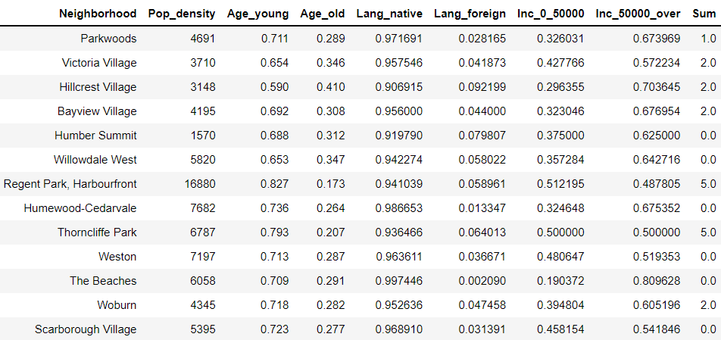
Summary Statistics I
The neighbourhoods across Toronto are fairly similar in age, although they do differ in ethnic makeup and wealth.
Regent Park and Harbourfront (Downtown Toronto) are the most densely populated
Thorncliffe Park is the lowest-income neighbourhood where 50% of the population's households earn less than $50,000
There are also a few neighbourhoods that have zero restaurants.

Slide 9
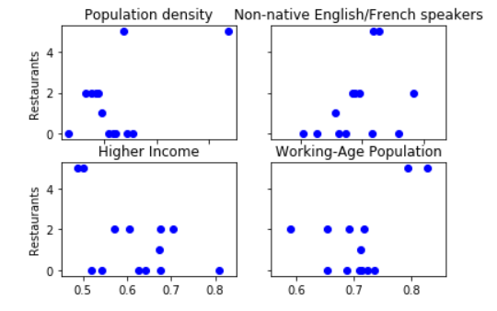
Summary Statistics II
Aside from the zero observations, positive correlation between the number of restaurants and population density and proportion of non-native English/French speakers.
Weak negative correlation between the number of restaurants and the proportion of high-income households.
It is possible that these demographic variables are correlated (younger people may have more income, for example) so that the correlation, *after controlling for confounding variables* may switch.

Slide 10
Results & Discussion
 | Coefficients | Standard Errors | T-Values
Population Density | 0.0001 | 0.000 | 0.636
Proportion of individuals between 15-55 years old | 16.1465 | 12.055 | 1.339
Proportion of households with income over $50000 | 1.0873 | 6.187 | 0.176
Proportion of non-native English/French speakers | 42.6274 | 20.105 | 2.120
Constant | -13.2330 | 11.068 | -1.196
R-squared | 0.59
Number of observations | 20
Other Covariates
Population density has a coefficient closer to zero
Perhaps higher number of residential buildings, less room for commerce
Higher income and younger -> as predicted, correlate positively
Non-native English/French speakers
Large, positive and signifiant coefficient
Cultural diversity has a positive impact on the number of restaurants!
R-squared is decently high at 0.59, however we may be missing some covariates such as:
Office spaces and transit nearby
Crime rates
Tax policies and rent
Zoning laws

Slide 11
Conclusion
Weak impact of demographic factors on number of restaurants except for the proportion of non-native English/French speakers
Supports hypothesis that cultural diversity increases number of attractions to an area
Model has low R-squared, 0.59 – more controls could be appropriate
Could be missing covariates: number of nearby office buildings, easy access to transit, crime rates, tax policies, rent
Takeaway
Increased cultural diversity could play a role in increasing the number of restaurants in an area and thus increasing economic activity
Having a greater choice of places to eat can increase the social welfare of people living and visiting a particular neighbourhood
Encouraging people of different ethnicities to settle in Toronto has economic as well as social benefits
However…
In order to make the findings more robust, policy-makers will have to include more controls and experiment with various regression forms

Slide 12
Thank you!
Questions?

